Slide 1


Open Science in Action: Building Skills, Crafting FAIR Resources, and Recognizing Achievement, Skills4EOSC
Dominique Green
WP2 Leader
Digital Curation Centre
(with thanks to Angus Whyte, DCC & Sara Di Giorgio, GARR)

Slide 2
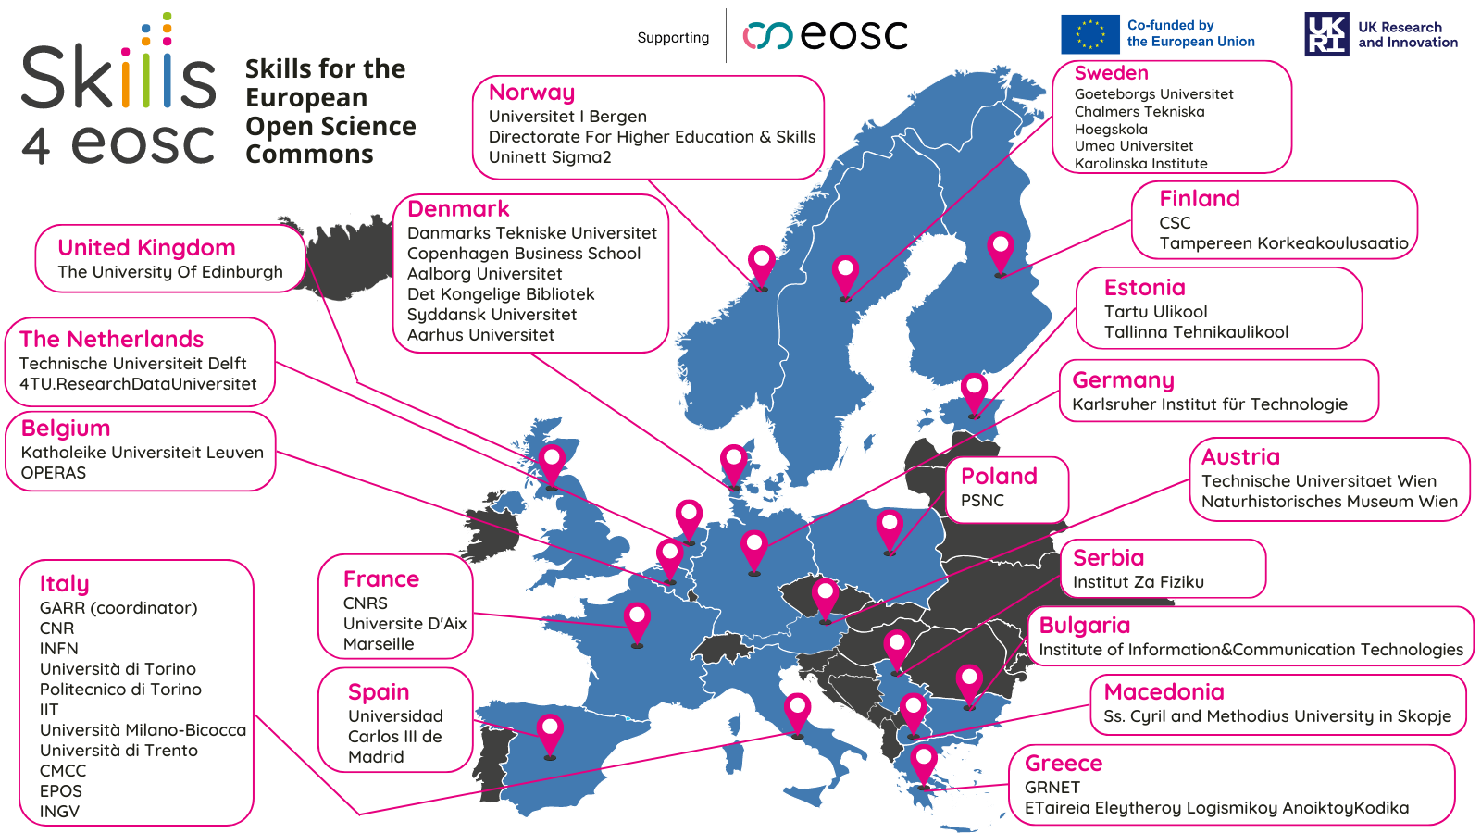

Slide 3


c
Key Concepts
Co-Creation
Minimum Viable Skillset
FAIR-by-design methodology for learning material
Training of Trainers
Professional Networks
Harmonising learning curricula
Competence Centre Network

Slide 4
Skills4EOSC’s main objective
Advance Open Science skills by unifying the current training landscape into a common and trusted pan-European ecosystem, closing the three gaps identified in the EOSC Strategic Research and Innovation Agenda about Open Science competencies:
lack of Open Science and data expertise,
lack of a clear definition of data professional profiles and corresponding career paths, and
fragmentation in training resources.

Slide 5





EOSC Strategic Research & Innovation Agenda
SRIA Priorities
Skills4EOSC contribution
Priority 2: Bridging the education gap: coordinating and aligning curricula for students and researchers
Priority 1: Developing the next generation of Open Science and data professionals
Skills4EOSC Network of Competence Centres
Minimum Viable Skillset defined for different roles acting in the OS context
Training of Trainers and FAIR by design methodology for learning materials
Supporting Professional Networks for lifelong learning
Target Science for Policy interface roles (policy makers, knowledge/honest brokers, civil servants)
Priority 4: Influencing national Open Science policy for skills by supporting strategic leaders
Priority 3: Building a trusted and long-lasting knowledge hub of learning materials and related tools

Slide 6
WP1 - Project Management
MAPPING&METHODOLOGY UPSKILLING ENGAGEMENT
WP2 - OS career profiles, skillsets and material - landscaping, certification and QA
Mapping skills Vs profiles
Methodology for FAIR material
Schemes for the certification/accreditation of acquired competences
Co-creation and monitoring
WP3 OS training for evidence-based policy
paths for civil servants, policy makers
empower researchers to communicate with decisionmakers
WP8
Synergies, Engagement comms advocacy
Promoting Outputs
Furthering activities at the national/regional level
Gaining support
Creating sustainability for national initiatives
ACADEMIC PATHS
WP4 Curricula and career paths
Academic paths (undergraduate, postgraduate, PHD, postdoc specialization)
Structured training paths for data professionals
WP5 Thematic Training for RIs professionals and communities
RI professionals
Infrastructure professionals
Research communities: SSH, Solid Hearth, Climate change, Museums
Legal & Ethics professionals
PROFESSIONAL TRAINING
WP6 Peer Networks
Peer Networks for professionals
Thematic Peer Networks
INFORMAL LEARNING
WP7: Competence centres and user support network
coordination and harmonisation - platforms & tools - exchange of competences - sustainability

Slide 7

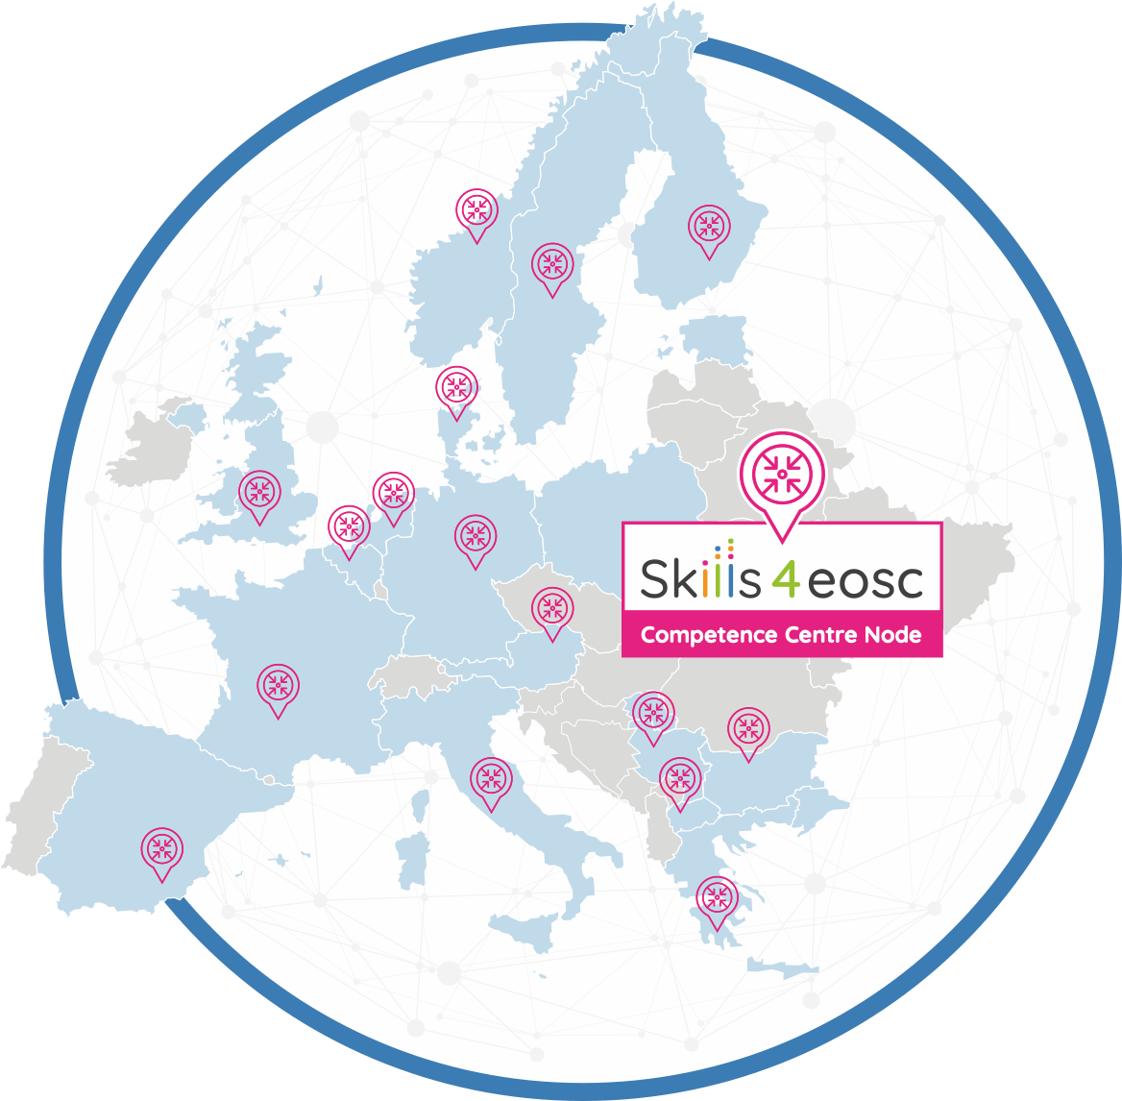


Skills4EOSC Competence Centre Network (CCNet)
Skills4EOSC aims at building a Network of Competence Centres for Open Science, FAIR and EOSC in Europe (CCNet).
25 June 2024 Public Lunch of the CCNet
8 Competence Centres are part of the Network (target KPI: 10)
Ongoing discussion wth other 10 CC
The CCNet is well recognised in the EOSC Ecosystem and beyond

Slide 8






Skills4EOSC Competence Centre
Provide a point of reference in a specific Country, Region, or Theme for key competences that enable Open Science to be practiced with adequate knowledge of standards, applications and tools and best practices for delivering, managing, re-using, sharing and analysing FAIR data, as well as other digital research objects.
Competences
People and Institutions
Services
Resources
Operational Tools
https://www.skills4eosc.eu/network

Slide 9
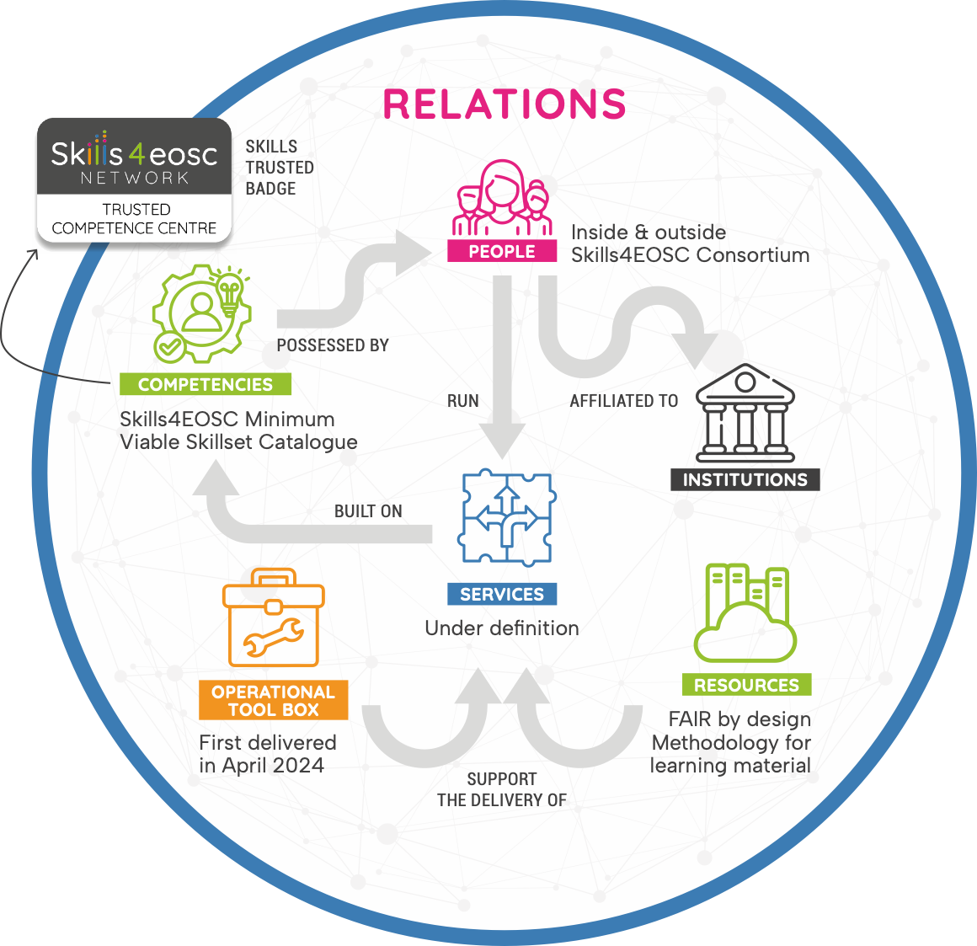


Skills4EOSC Competence Centre
Skills4EOSC CC represent a point of reference in a specific Country/Region/Theme to find key competences to enable the practice of Open Science with adequate knowledge of standards, applications and tools and best practices for delivering, managing, re-using, sharing and analysing FAIR data, as well as other digital research objects.

Slide 10
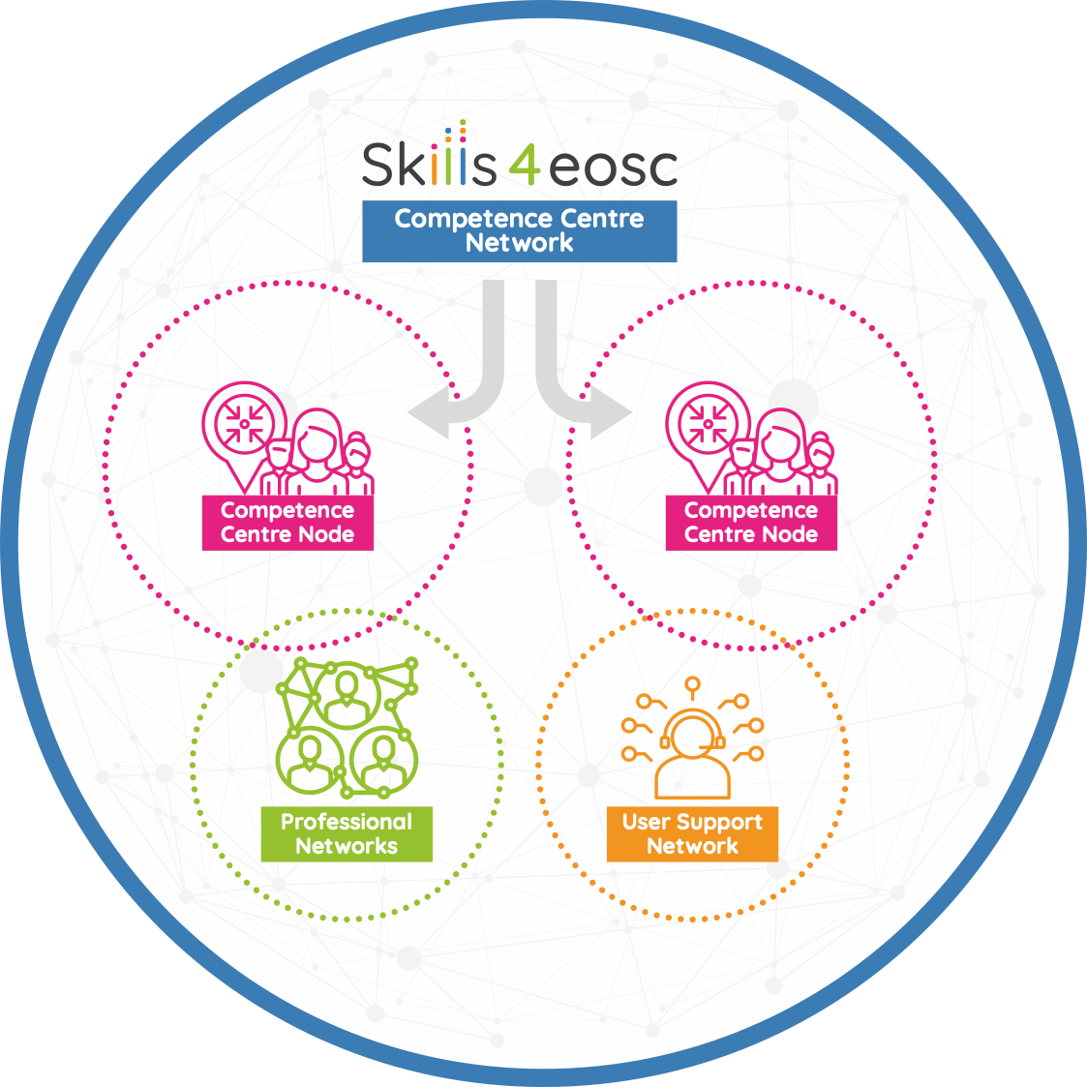
Link with Local Network
Skills4EOSC Competence Centres can be built involving local members that are not part of the Consortium.
13 Local Networks lauched in 11 countries (target KPI 7 Networks in 7 countries)
10 User Support Networks engaged

Slide 11
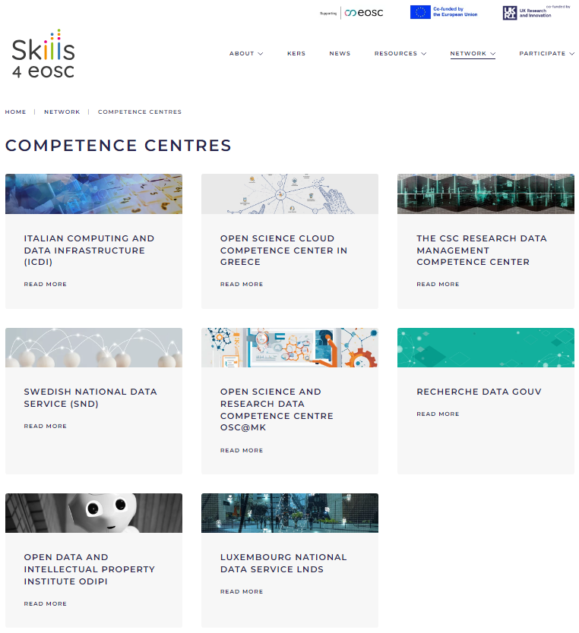
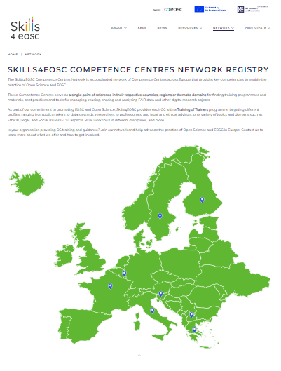
Skills4EOSC CCs Registry

Slide 12


Skills4EOSC Offering to Competence Centres
Harmonised profiles and curricula for the 'EOSC actor' |  | Minimum Viable Skillset defined for different roles acting in the OS context
FAIR-by-Design methodology to improve accessibility and reusability of learning materials |  | FAIR by design Handbook and Microlearning path on Github, Courses, Leaflet
Shared Recognition Framework for learning materials, trainer certification, and accreditation |  | Guidelines including Open Badges and European Digital Credentials
'Train the Trainers' programme tailored to different profiles and research domains |  | Courses with self-paced and live sessions, learning materials ready to be re-used and adapted

Slide 13


Skills4EOSC Offering to Competence Centres
Development of professional and user support networks |  | Starter Kit for the creation of new Network, mapping and harmonisation of existing ones
Guidelines on IT services to foster collaboration and sharing |  | Best practices and methodologies across CCs to support collaborations and activities
Sustainability strategies of the Competence Centre(s) Network |  | Action plan to maintain and enrlage the Network
Influencing national Open Science policy for skills by supporting strategic leaders |  | Target Science for Policy interface roles (policy makers,knowledge/honest brokers, civil servants)
Space for discussing common issues and positions in the EOSC ecosystem |  | Networking & collaboration on common challanges

Slide 14






Competences Definition
Design learning paths & material
Training of Trainers delivery
National courses training target roles
Skills4EOSC defines a minimum set of competences for each target in the Minimum Viable Skillset
Through the FAIR by design methodology, learning materials for Training of Trainer programmes are developed
Training of Trainers will be delivered to a group of Master Trainers to multiply the specific competences inside the Skills4EOSC Consortium
Once Master Trainers are equipped with adequate competences, they will organise courses to train target roles in their country/community
Y3 & onward
Year3

